Slide 1
VALUE PROPOSITION
TARGET INNOVATOR: GO - GETTER
Notes:
Design of content to be relooked

Slide 2
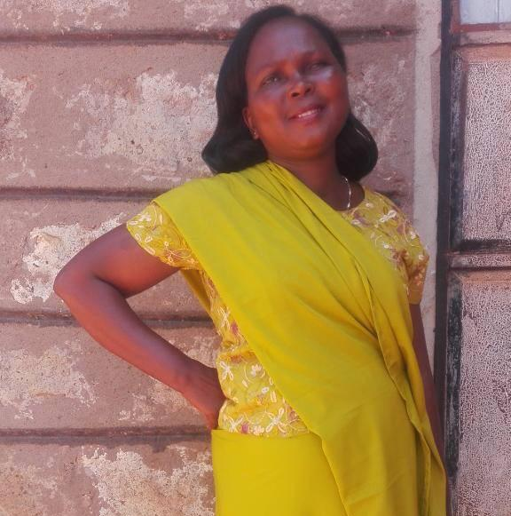
ASPIRATIONAL & OPTIMISTIC
Pride and status are key drivers
Proud to provide for themselves and their family
Wants to be seen as advancing and modern
High emotional reward in the purchase of new products
Seeks new ideas and tools to improve their business
Loves products that make life easier
Target Innovator | Go-Getter
Mary or Mark Otieno
26 - 45 years old
Small business owner
Married, 2-3 children
Lives in Target 29 Neighborhoods
Income Ksh 30,000 - 50,000
PRACTICAL & STRAIGHTFORWARD
Always busy, works long hours (hustler)
Will make sacrifices and compromises in order to make ends meet
Cooking Solution: 1 burner LPG + charcoal jiko + kerosene cooker
Location: Urban
Education: High school / some college
Associations: Church group, trade association, savings group
Devices & Platforms: Android smartphone
Social Media: WhatsApp, Facebook, Active on the chama WhatsApp group
Radio: Vernacular, gospel (Radio Maisha, Hope FM, Jambo, Kameme, Milele)
TV: Soap operas, local news, live sports, religious shows
CAUTIOUS & RISK AVERSE
Afraid of being scammed
Concerned about safety in their home
Skeptical about availability and reliability of a product / consumables
Interested in how to resolve a product issue
SAVING & BUYING HABITS
Saves daily
Accesses larger sums of money through savings or chamas
Ensures that expenditures fit into their daily income
Prefers to gather their information from a trusted source
Believes in products when they see it in action

Slide 3
Target Innovator | Go-Getter
MARY & MARK’S EXPERIENCE WITH FUELS
Loves the 1 burner LPG because it is fast and clean
LPG 6kg cylinder lasts 3-4 weeks. Refilling costs Ksh 800 - 1,000
Worries about the safety of her children around the 1 burner LPG when they’re not in the home
Stresses that the LPG will run out unexpectedly and they won’t have the money to refill the cylinder
Concerned that the LPG purchased is not standard/accurate because sometimes it runs out faster than expected
Has 2 delivery contacts from the neighborhood who deliver the filled cylinder for free but occasionally Mark gets the LPG from the nearest vendor
Reluctantly uses charcoal or kerosene when the LPG runs out, which makes their small house smell bad
The burner part of the meko that regulates the flame keeps breaking and has to be replaced every 4-6 months for ~Ksh 600
Aspires to upgrade to 2 burner LPG but has not saved enough through her chamas for the upfront cost of a 2 burner cooker, 13 KG cylinder, regulator, and hose
Mary or Mark Otieno
26 - 45 years old
Small business owner
Married, 2-3 children
Lives in Target 29 Neighborhoods
Income Ksh 30,000 - 50,000
MARY’S COOKING HABITS
Everyday uses 1 burner LPG to cook short meals (<1 hour) e.g. tea, rice, ugali, vegetables, meats
Boils ~5 Litres of bathing water for the family every evening using kerosene
Uses charcoal jiko on weekends to cook long meals (>1 hour) e.g. githeri and cereals and also to prepare chapati
Uses kerosene cooker when LPG runs out unexpectedly
Prefers to cook a lot of food in the evening. The leftover food is warmed for the househelp and kid the next day for lunch
Occasionally buys pre cooked cereals and fries them

Slide 4
Bullseye target customer for KOKO
Key Parameter | Habits, Attitudes & Limitations
What she currently cooks with | A 1-burner LPG (meko) because she finds it convenient and easy to use and start up costs are within reach
Current issues & challenges of using a meko cooker | Can only cook one dish at a time so cooking takes longer LPG costs are high and she doesn’t always have the money when LPG runs out forcing her to keep a kerosene and/or jiko as backup She does not enjoy cooking with a kerosene cooker or a jiko as its messy and not safe She also worries about LPG cooking due to its risk of explosion in case of LPG leakage
What cooking appliance she aspires for? | A 2-burner LPG cooker as this would be even more convenient and faster, making cooking more enjoyable. Also safer as cylinder has a safety valve.
What are her limitations towards getting a 2-burner LPG cooker | Startup costs are too high Replenishing 13kg LPG cylinder is even more expensive - out of reach Therefore upgrading to a 2-burner LPG cooker remains a dream that can only be realised if her economic status improves.

Slide 5
Competitive Landscape - KOKO vs. LPG Cookers
Cooker Comparison
Fuel Comparison
Attributes |  | 1-burner LPG (Meko) | 2-burner LPG Cooker | 2-burner KOKO
StartUp Costs |  | Most affordable | Most expensive | Cheaper than 2-burner LPG
Attractiveness |  | Less attractive | Parity | Parity
Cooking Speed |  | Slowest | Fastest | Fast
Ease of lighting Up |  | More difficult | Easiest | Easy
Full Power Achievement |  | Parity | Parity | Slower
Pot Stability |  | Less Stable | Parity | Parity
Flame control |  | Harder | Parity | Parity
Attributes |  | 1-burner LPG (Meko) | 2-burner LPG Cooker | 2-burner KOKO
Cost of Fuel/litre or Kg |  | 175/Kg | 167/Kg | 95/Litre
Cost of Fuel/Purchase |  | Ksh 800-1,000 | Ksh 2,170 | From Ksh 35
Cost of Fuel/Meal |  | Cheapest | Cheapest | Most expensive
Fuel replenishment |  | Delivered | Delivered | KOKOPoint
Refill points availability |  | More available | More available | Less available
Risk of Fire |  | Explosive | Explosive | Lowest
Risk of fuel run-out unexpectedly |  | High | High | Lowest

Slide 6
KOKO Discriminator
What’s the one key thing that only KOKO can do versus LPG cookers ?
Only KOKO with its SMART FUEL TECHNOLOGY brings you the MOST AFFORDABLE, MOST CONVENIENT and SAFEST 2-burner cooking experience you desire
KEY DIFFERENTIATOR
ACCORDS THESE KEY BENEFITS TO CONSUMERS
SMART FUEL TECHNOLOGY
That enables fuel to be replenished in small quantities
That allows consumers to see how much fuel they have left as canisters are transparent
Hence enables consumers to operate without an undesirable back-up cooking alternative such as kerosene or jiko
MOST AFFORDABLE
MOST CONVENIENT
SAFEST 2-BURNER COOKER

Slide 7
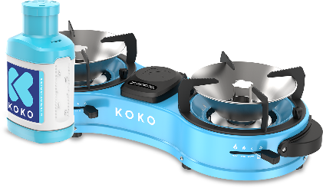
KOKO Value Proposition
From
To
THE NEW WAY TO COOK
THE SMART WAY TO COOK
REASONS
It’s the most affordable 2-burner cooker in the market
It’s the safest cooking option
It’s the most convenient way to cook because
It cooks fast with 2 burners
It lights easily
No need for backup cooking alternative because fuel can be purchased in small, affordable quantities so you never have to worry about fuel running out
SMART covers many aspects
Smart design and technology
Smart consumer - savvy, modern and discerning
Smart cooking - clean, enjoyable, modern cooking

Slide 8
SUMMARY - KOKO Foundation Architecture
1 | PRODUCT DESCRIPTOR What is KOKO? | SMART FUEL TECHNOLOGY KOKO offers its Smart Fuel Technology that delivers a 2-burner LPG-like modern cooking experience with a capacity to replenish low quantities of fuel anytime. SMART - Modern, stylish and technology enabled FUEL - Uses non-fossil, safe, clean and renewable energy TECHNOLOGY - Design that enables fuel to be replenished in small quantities
2 | PROPOSITION Value that only KOKO offers consumers | THE SMART WAY TO COOK Only KOKO with its Smart Fuel Technology brings you the Most Affordable, Most Convenient and Safest 2-Burner cooking experience you desire
3 | REASONS TO BELIEVE Supporting evidence | MOST AFFORDABLE | MOST CONVENIENT | SAFEST
4 | CONSUMER BENEFITS | Unbelievable startup cost for a 2-burner cooker Can buy fuel in small quantities | It cooks fast with 2 burners It lights easily and obtains optimum heat fast No need for backup cooking methods - jiko or kerosene | Low risk of fire as fuel is non explosive Low risk of fuel leakage

Slide 9
Core Customer Attributes - What They Look For
Affordability
Fuel purchases lasts as per expectation
Low cash outlay - fuel can be purchased in small quantities
Lower start up costs
Safety
No health or fire hazard from cooking appliance or fuel used
Availability
Replenish fuel easily
Close proximity of fuel stockist to my home
Convenience
Ability to complete cooking faster - a 2-burner cooker is preferred as it can cook 2 dishes together
Lights up easily without mess

Slide 10
KOKO’s Competitive Deliverables
Affordability
Fuel can be purchased in small quantities hence lower cash needed to refill
Offers the lowest priced 2-burner cooker in the market
Safety
No health or fire hazard from cooking appliance or fuel used and no residual smell
Availability
Accessible fuel refill points, readily available near my house
Easily portable as it comes in small quantities
Convenience
Ability to cook 2 dishes at the same time hence faster cooking
Lights up easily and attains optimum heat fast
Operate without a backup cooker because I can purchase fuel in small quantities and see when my fuel is about to run out

